Slide 1
Changes in and effects on interoceptive sensitivity over one-month
Experiment in Kita-Hiroshima-Cho
2023/5/16
Toru Maekawa
Notes:
Today, I would like to report on the results of a social experiment conducted in Kitahiroshima Town.
We measured interoceptive sensitivity twice in Kitahiroshima-cho over a period of one month. At the same time, we also measured autonomic nervous system-related physiological reactions and brain waves under stress load.
Today, I will present the results of these measurements.

Slide 2
Background
Unusual physiological reaction
Pollatos et al. (2007)
Herbert et al. (2010)
Palpitations
Hyperventilation
Insomnia
Diarrhea
Chronic stress
Traumatic events
Impaired interoception
Schaan et al.
(2019)
Khalsa et al. (2018)
Bonaz et al. (2021)
Mental illness
Panic Disorder
Depression
PTSD
Based on cross-sectional study
Notes:
As you know, many studies have pointed out the impact of interoception on mental health.
The figure briefly illustrates the hypothesized process by which interoception affects mental health.
When stress is high, the sensitivity of interoception becomes poor. This results in bad physical reactions such as heart palpitations, hyperventilation, insomnia, and diarrhea, as well as mental disorders such as panic disorder, depression, and PTSD.
There are many studies showing these relationships. A few of them are listed here.
However, all of these studies are cross-sectional and only show these correlations. Longitudinal studies may give us more information about the impact of interoception on mental health because they reduce the influence of interindividual variation.

Slide 3
Background
異常な生理反応
Pollatos et al. (2007)
Herbert et al. (2010)
動悸
過呼吸
不眠症
下痢
ストレス
内受容感覚
の異常
Schaan et al.
(2019)
Khalsa et al. (2018)
Bonaz et al. (2021)
精神疾患
パニック障害
うつ病
PTSD
Based on cross-sectional study
Notes:
As you know, many studies have pointed out the impact of interoception on mental health.
The figure briefly illustrates the hypothesized process by which interoception affects mental health.
When stress is high, the sensitivity of interoception becomes poor. This results in bad physical reactions such as heart palpitations, hyperventilation, insomnia, and diarrhea, as well as mental disorders such as panic disorder, depression, and PTSD.
There are many studies showing these relationships. A few of them are listed here.
However, all of these studies are cross-sectional and only show these correlations. Longitudinal studies may give us more information about the impact of interoception on mental health because they reduce the influence of interindividual variation.

Slide 4
パニック障害
うつ病
PTSD
精神疾患
Khalsa et al. (2018)
Bonaz et al. (2021)
内受容感覚
異常
Schaan et al.
(2019)
Pollatos et al. (2007)
Herbert et al. (2010)
ストレス
異常な生理反応
動悸
過呼吸
不眠症
下痢

Slide 5
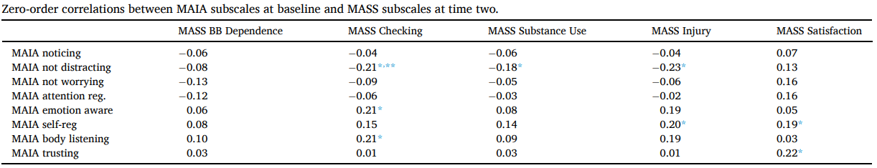
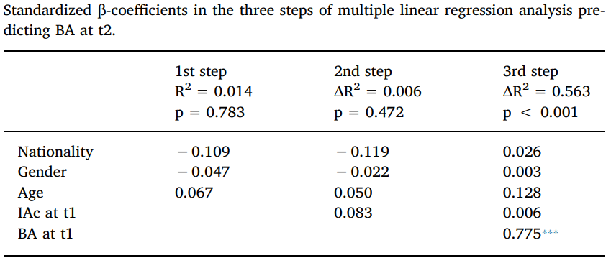
Longitudinal study
MAIA subscales predicted degree of muscle dysmorphic disorder at 4 weeks (Grunewald et al., 2023)
Interoceptive accuracy did not predict body awareness over an eight weeks period of time (Ferentzi et al., 2018)
Dissatisfaction with body image 8 weeks later was not predicted by interoceptive accuracy (Drew et al., 2020)
Very few longitudinal studies, some with negative results
Notes:
To my knowledge, the number of longitudinal studies on interoceptive changes is very small and non-directive.
One study showed that "a subscale of the MAIA predicted the degree of muscle dysmorphic disorder after 4 weeks.
This table shows the results, with MAIA values weakly correlating with the degree of muscle dysmorphic disorder after 4 weeks.
On the other hand, the two studies below found no correlation between long-term changes in interoceptive sensitivity and physical parameters.
To my knowledge, there are no direct, longitudinal interoceptive studies showing significant results.

Slide 6
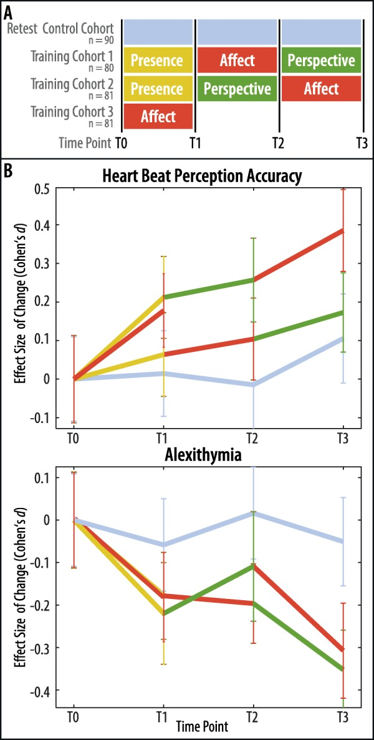
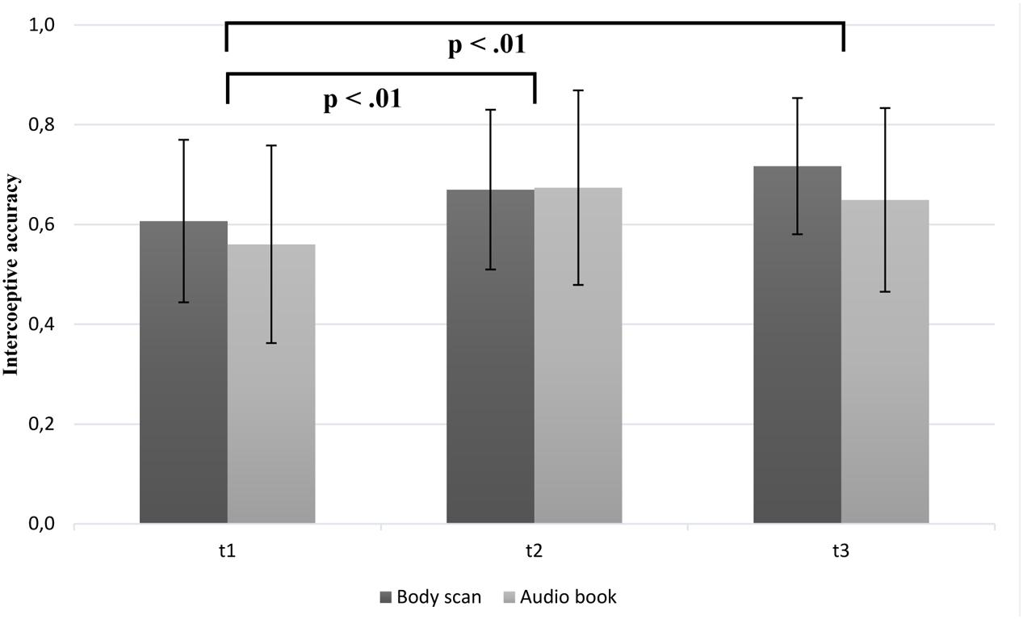
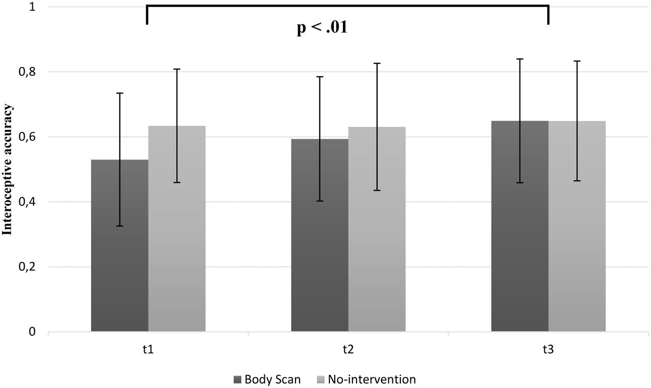
Interventions
Parkin et al., 2013; Antony et al., 1994; Mussgay et al., 1999; Bornemann & Singer, 2017; Fischer et al., 2017
Long-term contemplative and social-emotional training improved interoceptive accuracy with small to moderate effect sizes after 6 and 9 months (Bornemann & Singer, 2017)
One sub-study of an 8-week body scan intervention significantly improved heart rate perception (Fischer et al., 2017)
While some studies have found improvements in interoceptive sensitivity with the intervention, others have not found significant effects
Notes:
As another example, several intervention studies have been conducted to improve the sensitivity of interoception.
Some have suggested that the sensitivity of interoception may be altered.
However, results have been inconsistent, with some studies finding significant effects and others finding no effects.
Among the five studies, three reported positive results and two reported negative results.
In one study, the authors conducted multiple social-emotional training exercises and recorded heart rate count task performance every 3 months.
As shown in this figure, the intervention improved heart rate counting performance.
In another study, an 8-week body scan improved heart rate counting task performance.
Again, however, the results were inconsistent.
プレゼンスモジュールでは、参加者は現在の瞬間の経験に注意を向けることを学びます。2 つの中心的な実践は、呼吸瞑想とボディスキャンです。
「影響」モジュールでは、参加者は自分自身や他者に対する優しさ、配慮、思いやりの態度に慣れます。
パースペクティブ モジュールでは、参加者はメタ​​認知に取り組み、自己と他者に対する認知的パースペクティブに取り組みます。

Slide 7
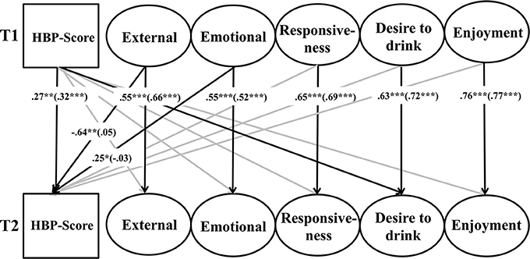
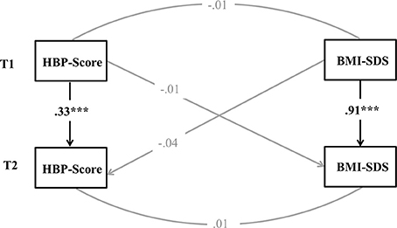
Stability of interoceptive sensitivity
Test-retest reliability for the tracking task was estimated to be up to 0.81 (Pollatos et al., 2007; Herbert et al., 2011)
Strong test-retest correlation of heartbeat perception in a four weeks period (r = 0.58; Mussgay et al., 1999)
A study investigating a big sample of children (N = 1657) between age 6 and 11 found relatively low stability of heartbeat perception (β = 0.33) after a year (Koch & Pollatos, 2014)
Notes:
Next, we discuss the stability of performance on the heart rate task.
Opinions differ as to whether interceptibility changes over a period of about one month.
There are several studies on stability, most of which report some degree of stability.
The correlations between the first and second intercepts are 0.81, 0.58, and 0.33, which is expected to show some stability, although it varies from study to study.
On the other hand, it is not known whether the remaining errors are due to changes in interoception or measurement error.

Slide 8
Research question
Effects of changes in interoceptive sensitivity over a month
Do changes in interoceptive sensitivity predict changes in (autonomic nervous system) physiological responses?
Do changes in interoceptive sensitivity predict changes in EEG under stressful conditions?
Do changes in interoceptive sensitivity predict changes in emotional/psychological state?
Notes:
Based on the above, the RESEARCH QUESTION for this study is as follows.
- Do changes in interoceptive sensitivity predict changes in (autonomic nervous system) physiological responses?
- Do changes in interoceptive sensitivity predict changes in EEG under stressful conditions?
- Do changes in interoceptive sensitivity predict changes in emotional/psychological state?

Slide 9

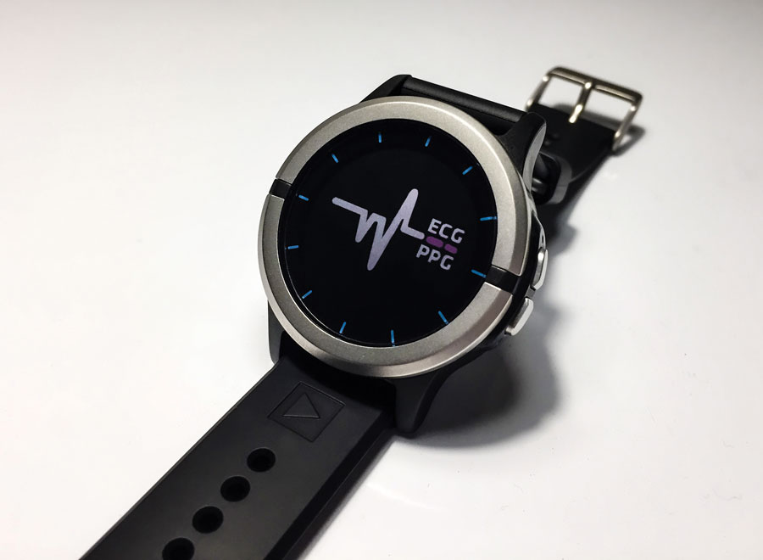
Procedure
N = 29
T0
T1
T2
1 month
1 month
Questionnaire
Questionnaire
Interoceptive sensitivity
Res-Q band
ARSQ, JPSS, MHQ, TIPI, BPQ, RS14
Heartbeat discrimination task
ADI watch worn daily at bedtime
Autonomic physiological, brain activity
Sleep length, quality
Heart rate
Respiration
SPO₂
Arterial stiffness
PPG
Blood pressure
EEG
Resting (5 min)
Mental arithmetic task
Notes:
I will describe the experimental procedure.
The experiment was conducted over a two-month period.
Participants participated in the experiment at T0, T1, T2 and once a month.
During the month between experiments, participants wore the ADI Study Watch every night to record physiological responses.
Participants visited the laboratory (town hall) three times.
At T0, they simply completed a questionnaire and did not perform any psychophysical experiments.
Participants performed some experiments only at T1 and T2.
The present study will focus on the comparison of the results of these two experiments.
In this experiment, participants' autonomic responses and EEG were recorded during a 5-minute rest and mental arithmetic task.
In addition, participants performed a heart rate discrimination task to measure interoceptive sensitivity.
They also completed a questionnaire.

Slide 10
Mental arithmetic task (T1, T2)
Response
Pre
task
Mental
arithmetic
Post
task
Resting
Questionnaire
Questionnaire
300s
30s
6s
30s
11s
30s
Autonomic physiological responses
EEG
Arterial stiffness
Blood pressure
Photo-plethysmogram (PPG)
Questionnaires
JPSS (Japanese Perceived Stress Scale)
MHQ (Mental Health Questionnaire)
TIPI (Ten Item Personality Measure)
BPQ (Body Perception Questionnaire)
RS14 (14-item Resilience Scale)
Mental arithmetic task
count mentally backwards, as fast and accurately as possible, in steps of 7 starting at 1000
Notes:
Now I will describe the task in detail.
The first is a mental arithmetic task.
This is a task that is often used to provide cognitive load and stress to participants.
Participants are asked to subtract 7 from 1000 and to repeat the subtraction, performing as many calculations as possible in 30 seconds.
The shaded areas in the figure indicate the time periods when physiological responses were used for analysis.
The physiological responses recorded were EEG, arterial stiffness, blood pressure, and photoplethysmogram.
Participants also completed a questionnaire on this list.

Slide 11
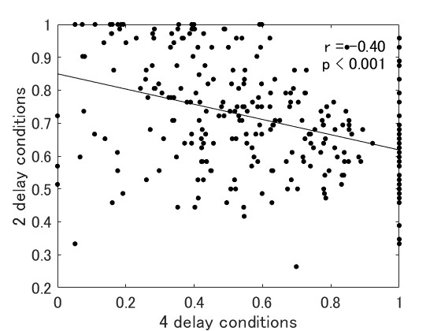
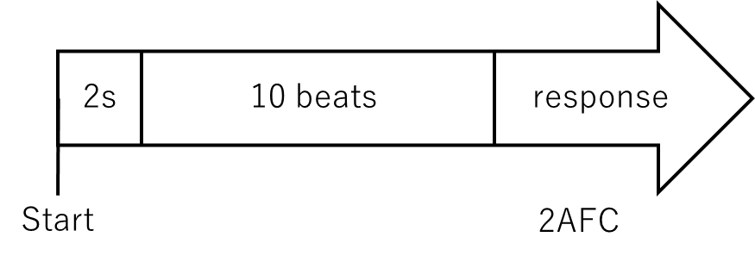
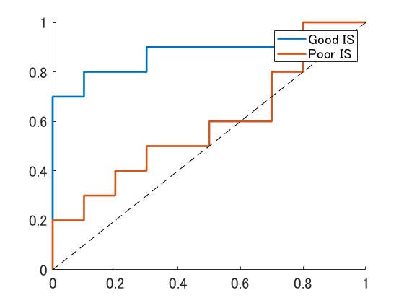
Heartbeat discrimination task (T1, T2)
Method
Preliminary experiment
10 beep sounds with delay added to R-peak
Participants judged whether the heartbeat and beep were simultaneous or not, and indicated confidence in their judgment.
Delay：0ms, 450ms
Repetition：10 times
2 delays×10 repetition＝20 trials
Correlation between the results of the 4 conditions and the 2 conditions: r = -0.40
Analysis
ROC
Receiver Operating Characteristic
AUC
Area Under Curve
Delay 450ms
Notes:
Next, I will describe the heartbeat discrimination task, which is a measure of interoceptive sensitivity.
In this experiment, I used a heartbeat discrimination task.
As you all know, the heartbeat discrimination task is a task to determine whether the timing of the beep and the heartbeat are synchronized.
Due to the limited time available for the experiment, we conducted a shortened version in two conditions.
As a preliminary study, I compared the results of the index analyzed in the four conditions with those of the index analyzed in only two conditions.
There was a correlation of 0.40 between the two conditions.
This indicates that the two conditions also produce measures that correlate to some extent with the four conditions.
Next, I will describe how I calculated the scores for the heart rate discrimination task.
In the heart rate discrimination task, participants are also asked to respond to their confidence level.
So, if we arrange the trials by confidence level and plot them according to whether they answered synchronized or not synchronized, we can draw the following ROC curve.
The area under this curve is called the AUC, which is the score for the heartbeat discrimination task.
Basically, if the discrimination rate is high for high confidence trials, the area of this curve will be larger.
This figure shows examples of high and low heart rate discrimination scores.

Slide 12
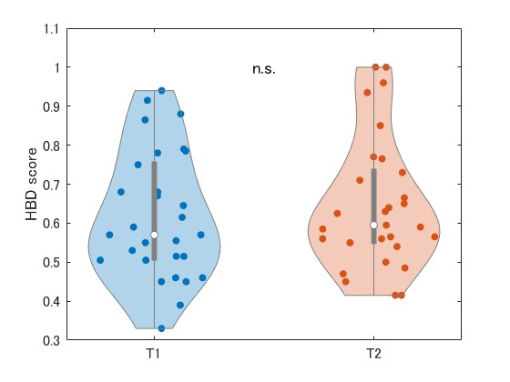
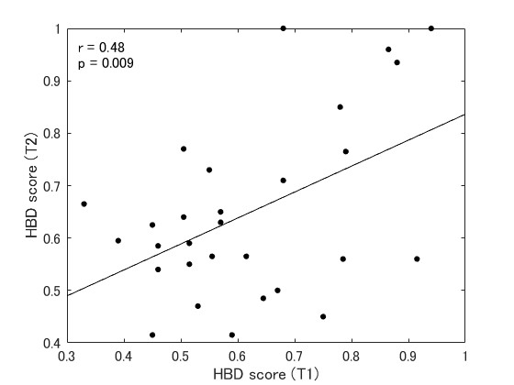
HBD test-retest reliability
t(28) = 0.91, p = 0.38
ICC: r(28) = 0.48, p = 0.009
Previous study, test re-test reliability: 0.33, 0.58, 0.81
⇒ The reliability of this study is of middle size
Notes:
I next report briefly on the results of the heart rate task.
The figure on the left shows the distribution of scores for the heart rate task at T1 and T2.
There appears to be a slight increase in scores at T2, but the difference is not statistically significant.
The right figure also shows the intraclass correlation coefficient between T1 and T2 scores to confirm the reliability of the scores.
The result is 0.48, indicating a medium level of correlation.
As mentioned earlier, previous studies have found correlations ranging from 0.33 to 0.81 in retest experiments.
The value of 0.48 in the present experiment is moderate and can be considered an average result.
Thus, the task was considered to have been performed adequately.

Slide 13
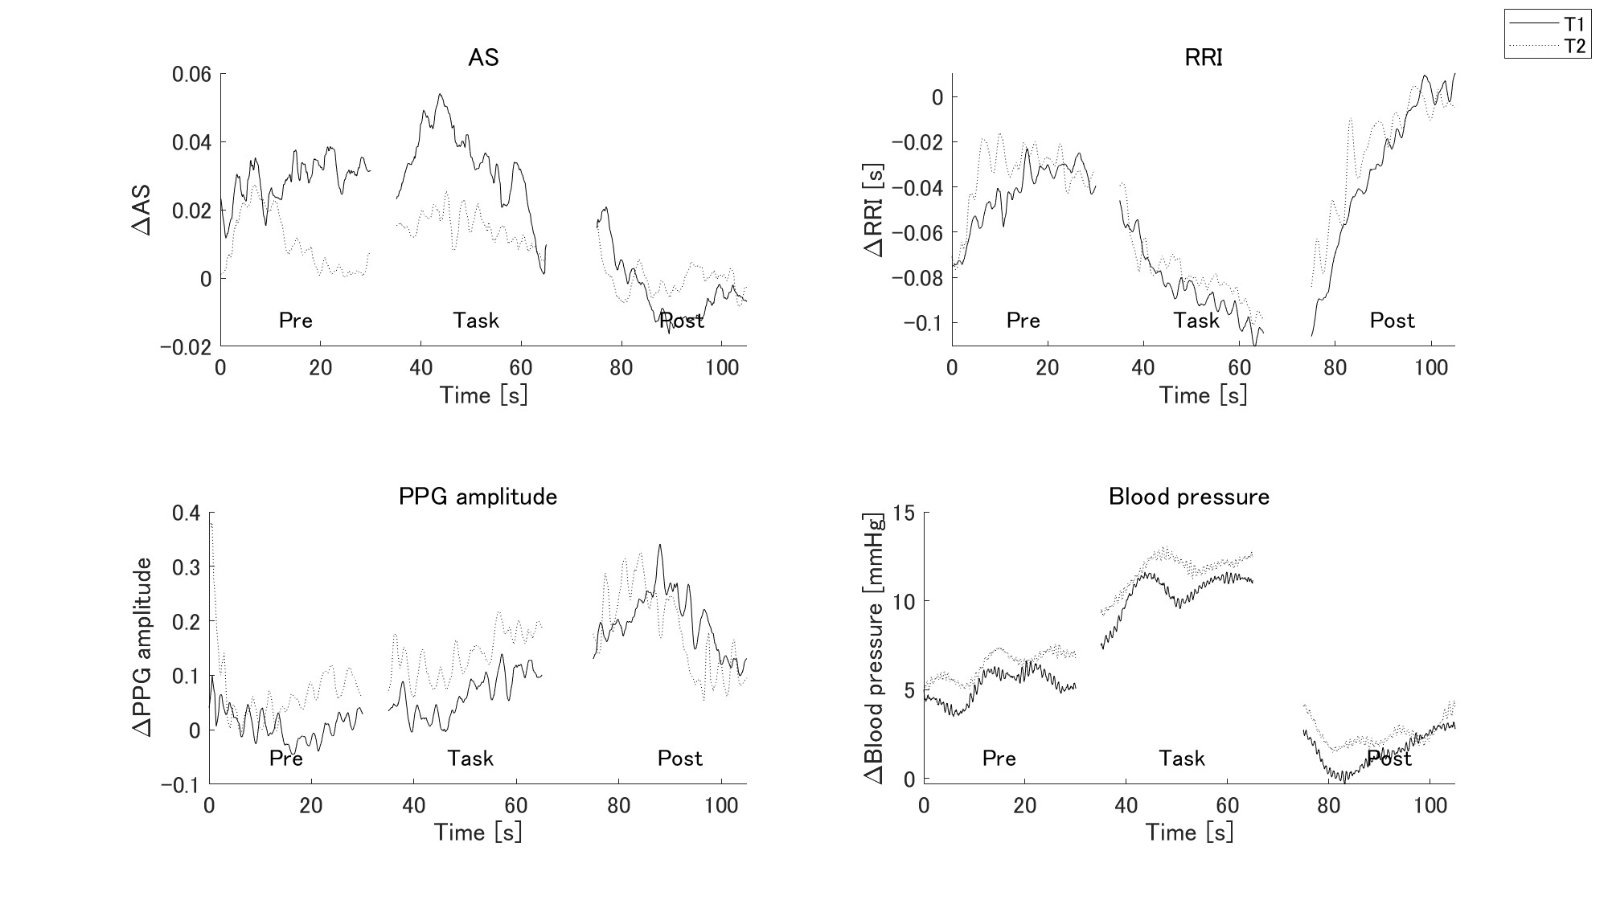
Mental arithmetic task: physiological response
Notes:
Next, I will show you the results of a mental arithmetic task.
First, I performed a manipulation check.
This is a plot of physiological responses during the mental arithmetic task.
This is the average of all participants.
The solid line represents the results of T1 and the dashed line represents the results of T2.
AS is an abbreviation for Arterial stiffness.
As many of you know, this is an autonomic index developed by Dr. Tsuji of Hiroshima University.
From the figure, we can see that AS rises during the mental arithmetic task and falls significantly at rest after the completion of the mental arithmetic.
Other physiological data also show similar responses.

Slide 14
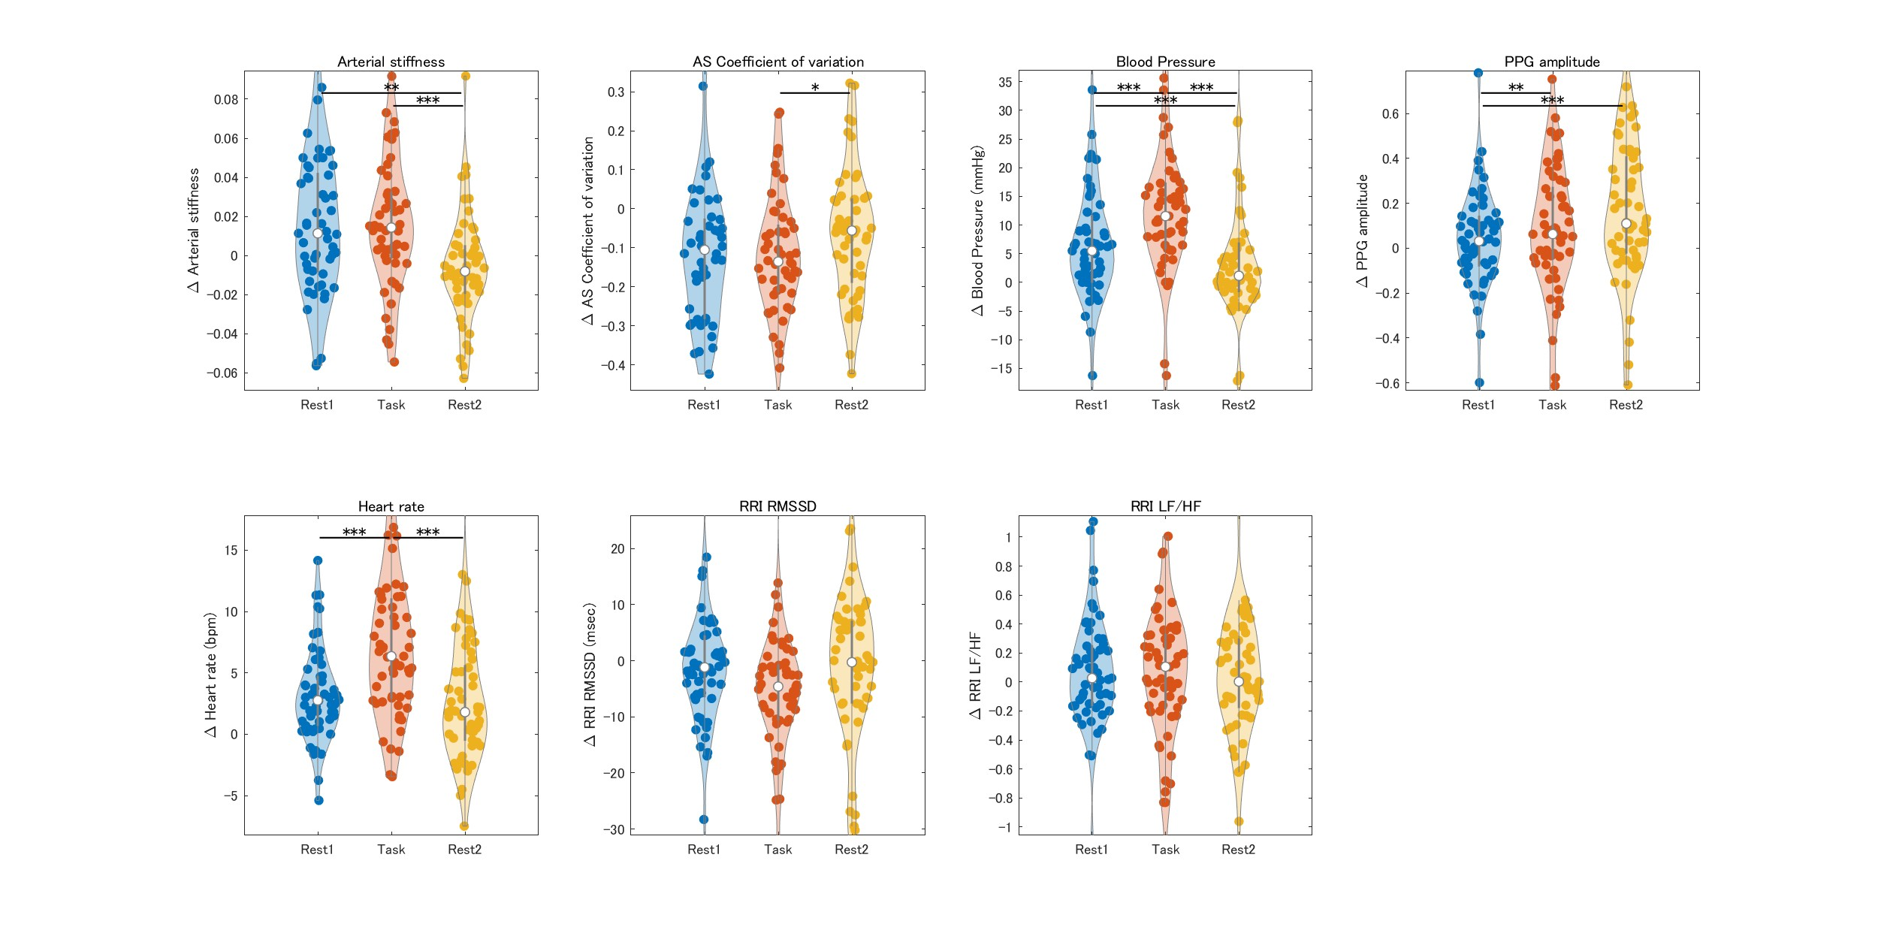
Mental arithmetic task: physiological response
* p < 0.05, ** p < 0.01, ** p < 0.001
Corrected by Tukey-Kramer HSD
Notes:
Next, I performed a statistical analysis.
I calculated the autonomic index before, during, and after the darkening and compared them with ANOVA.
The results showed significant differences in some, but not all, indices.
The most significant effects were seen in blood pressure and heart rate, which increased during the task and decreased after the task.

Slide 15
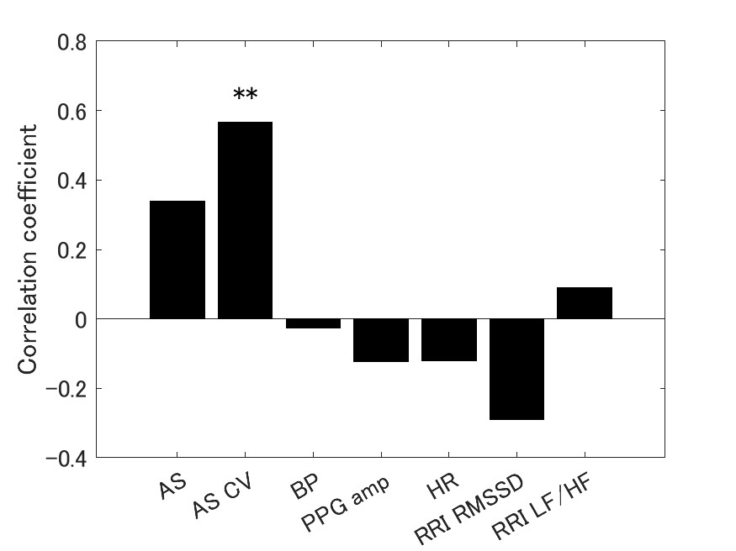
Comparison with HBD score
r = 0.32
r = 0.57
r = 0.20
Those with increased HBD score from T1 to T2 also had increased recovery
Pre
Post
Relaxation at the end of the task increases the coefficient of variation of arterial stiffness
Recovery Effect =
(CV of Post) - (CV of Task)
HBD score were positively correlated with AS recovery effect
Notes:
Based on the results on the previous slide, I compared them to the changes in the heartbeat identification task.
First, as you saw on the previous slide, physiological responses increase or decrease during the task and recover after the task is completed.
This is an example of the coefficient of variation of AS.
Therefore, I used the magnitude of recovery after the end of the task as the recovery effect as a measure of physiological response.
Comparing the recovery effect of AS CV with the score of the heart rate discrimination task, a weak positive correlation was found for both T1 and T2.
Thus, it was suggested that those with better interoceptive sensitivity were more effective in recovery after the dark task.
To further examine the change from T1 to T2, I calculated and plotted T2 minus T1.
As a result, a strong positive correlation was found.
Thus, the increase in interoceptive sensitivity over the course of a month was associated with a greater effect of recovery from the rote counting task.
However, this correlation was observed only in the CV of AS.
This figure plots the correlation between heartbeat discrimination sensitivity and other physiological parameters.
Although limited, this is the first major result of this study.

Slide 16
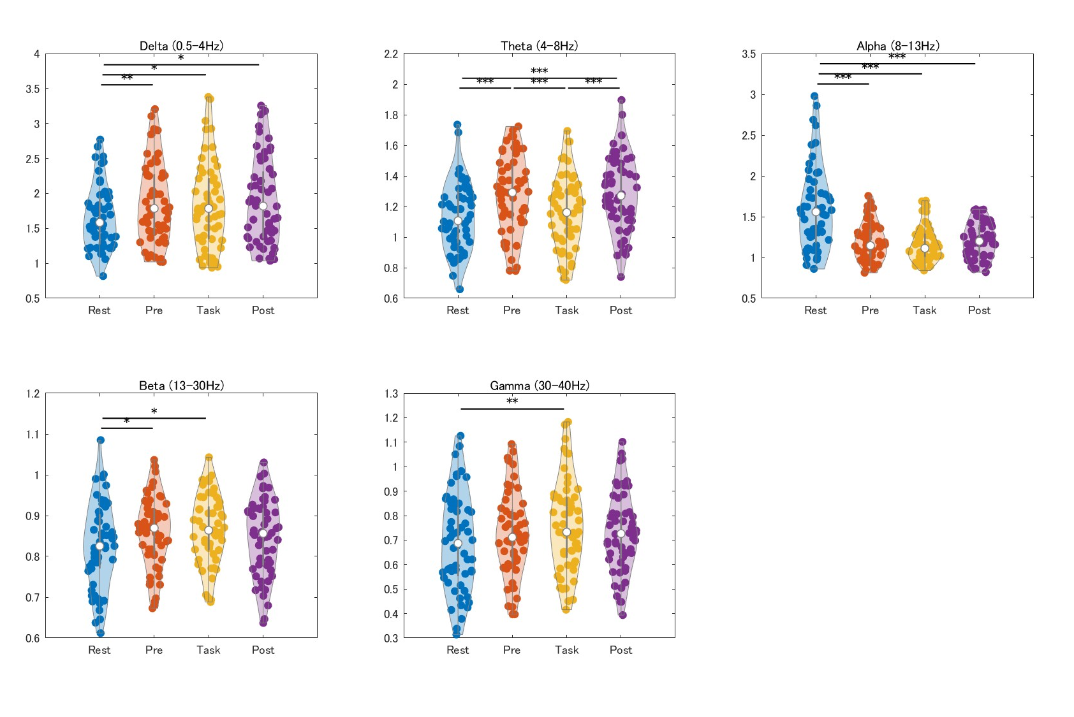
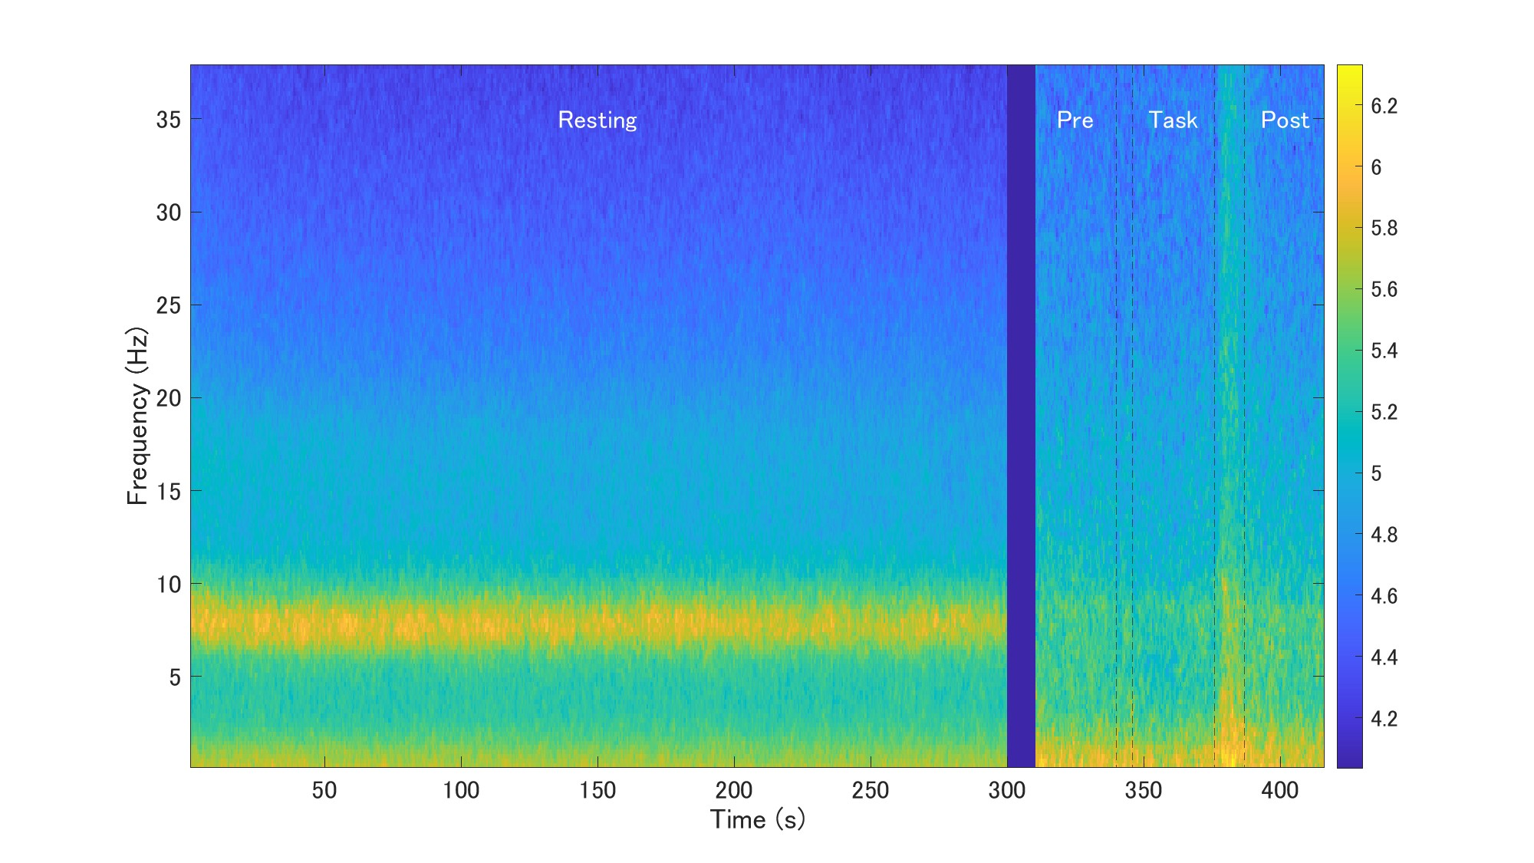
Mental arithmetic task: EEG
Notes:
Next, I performed EEG analysis.
The left figure shows the time-frequency analysis.
This is at rest for 5 minutes, and these are the time periods before, during, and after the dark calculation task.
You can see that alpha waves are stronger during the resting period and weaker during the mental arithmetic task.
The figure on the right shows the results of an ANOVA comparing these results.
Each figure shows the results for each frequency band.
As you can see, there is a large difference in EEG at rest and during the task.
However, when we focus on the mental arithmetic task, we do not see such large differences in the EEG before, during, and after the task.

Slide 17
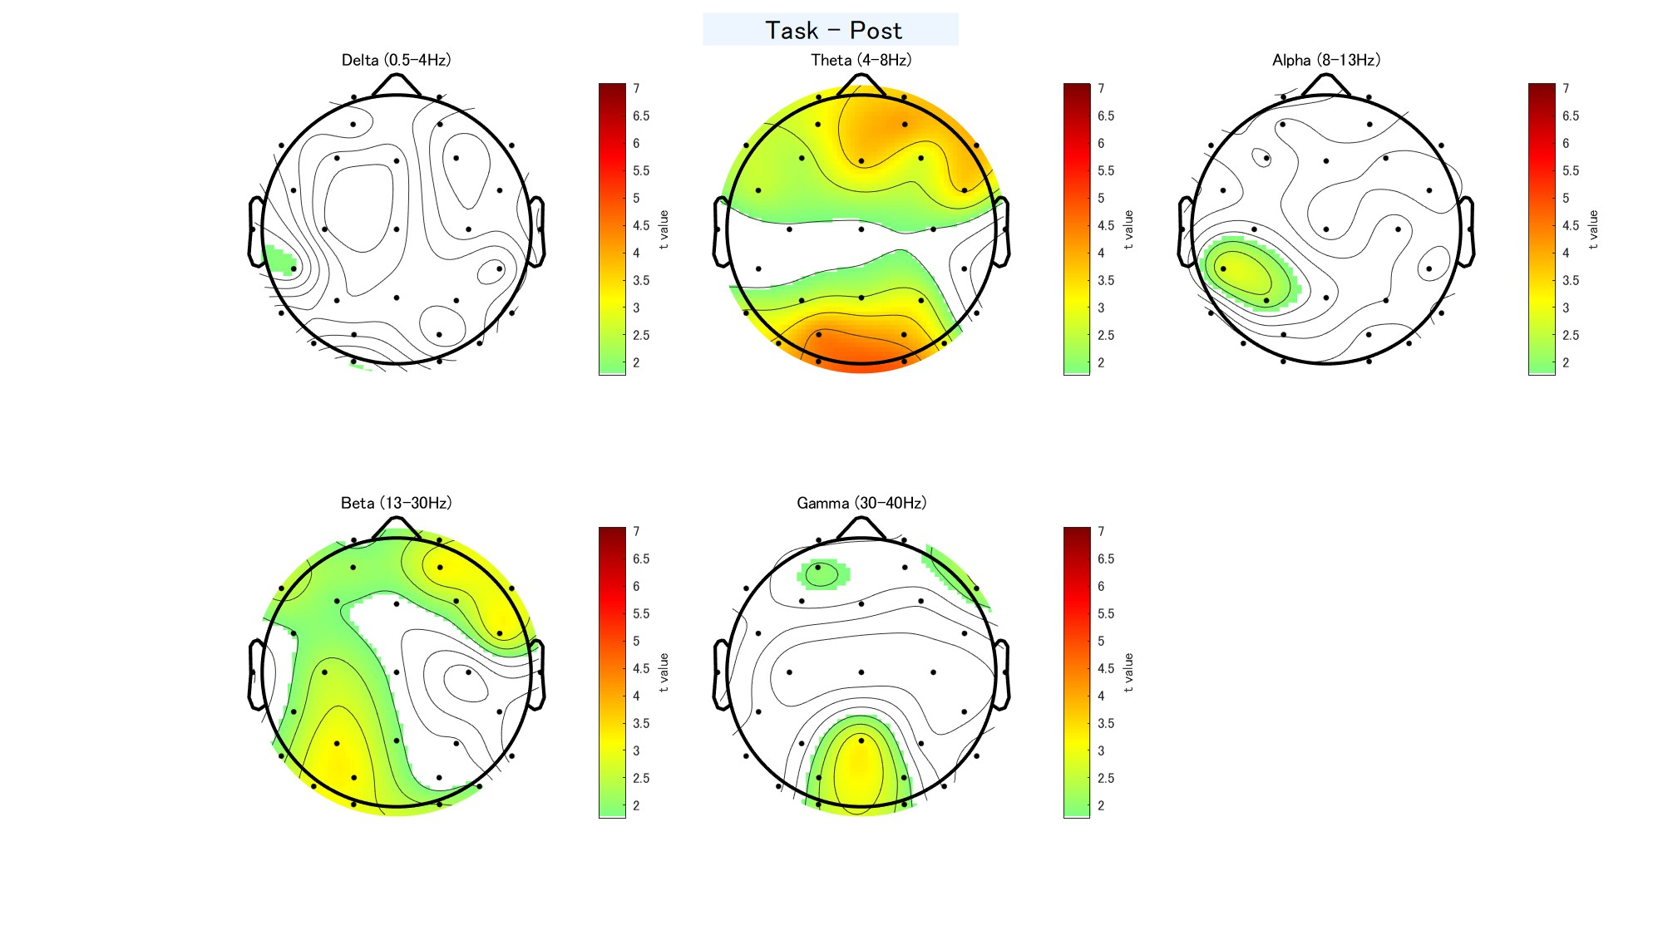
Mental arithmetic task: EEG
Task vs Post
Notes:
Since there seems to be a difference, albeit weak, in the EEG, I drew a topo plot to see where the difference lies.
This is a t-test of the difference between during and after the task, and the t-values are plotted.
The colored areas are the channels where significant differences were found.
There seems to be a difference in activity slightly to the right for the frontal and slightly to the left for the occipital.

Slide 18
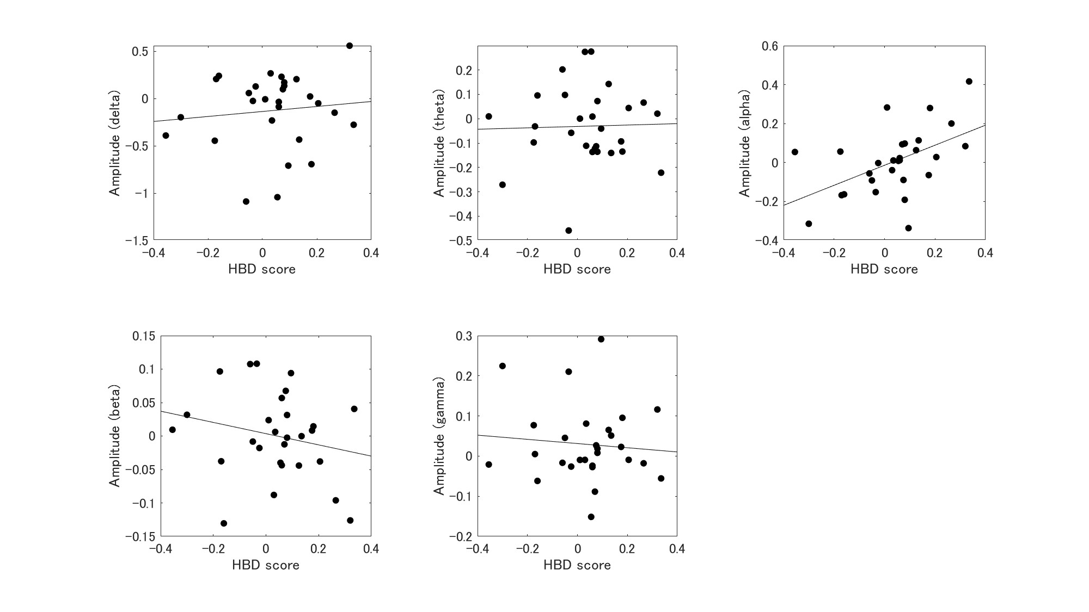
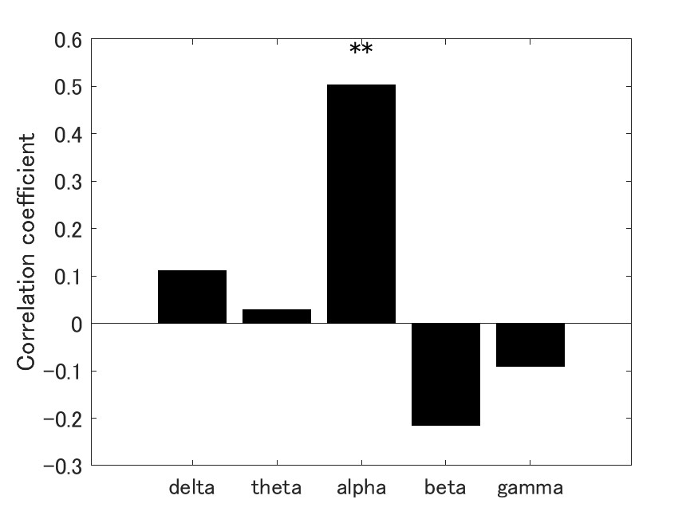
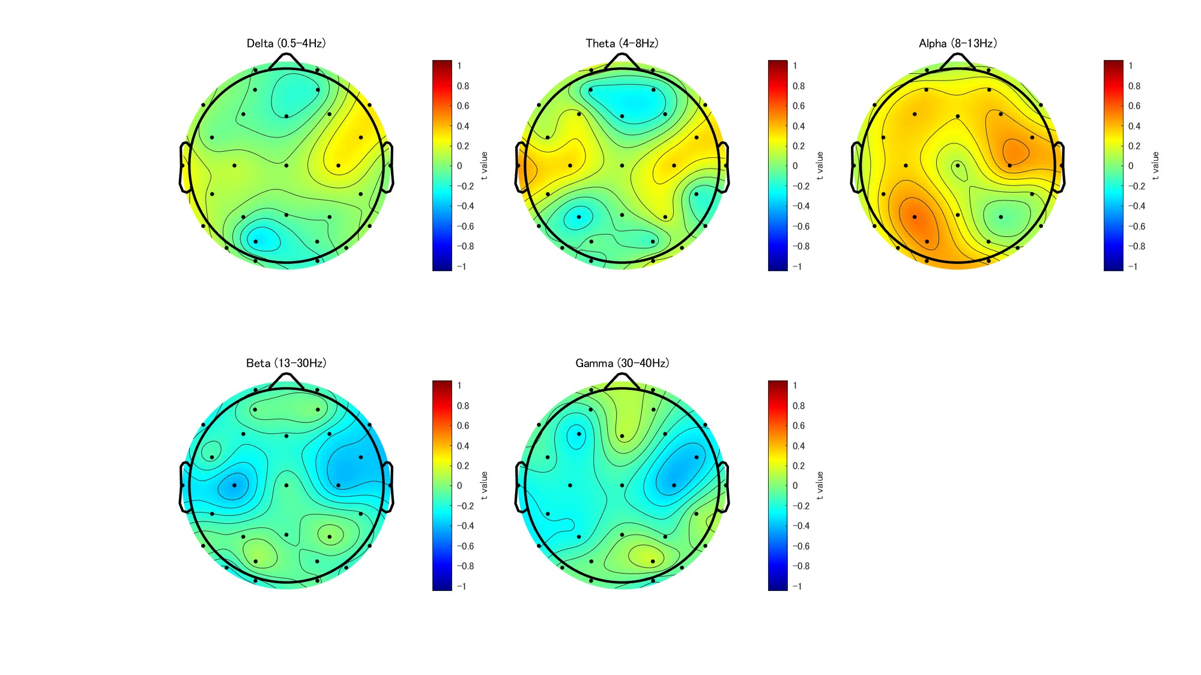
Comparison with HBD score
Correlation coefficient between HBD score (T2 - T1) and EEG (Post - Task and T2 - T1) by frequency
Notes:
I then defined the channels in which differences were observed in the topo plots as regions of interest.
I then compared the activity in the region of interest to the change in heartbeat discrimination sensitivity.
The left figure shows the correlation coefficients for each frequency band, and the right figure is a scatter plot.
As you can see, there is a significant correlation only for alpha waves.
This is the second main result of this study.
And this is a topo plot of the correlation between each channel and heart rate discrimination sensitivity.
As expected, there is a strong correlation for alpha waves.
The correlation is split into left and right, but I don't have a good explanation for this so far.

Slide 19
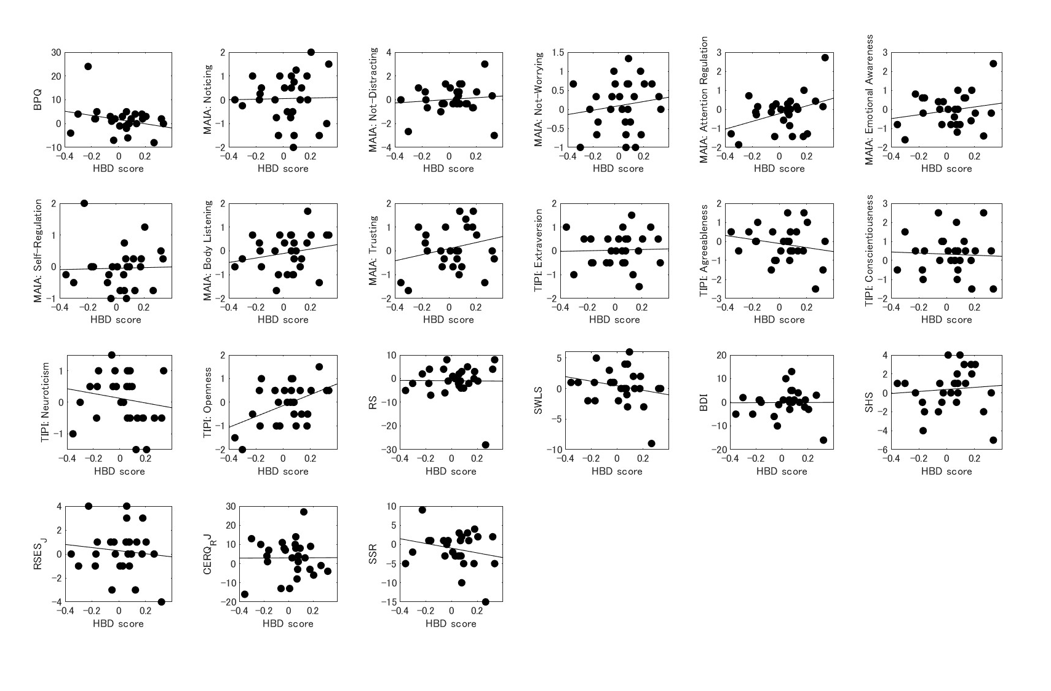
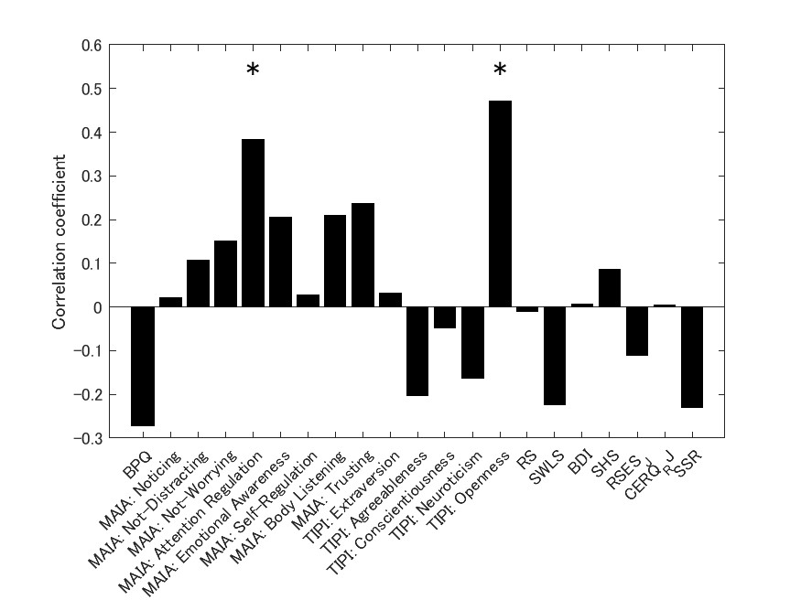
HBD and questionnaire
Notes:
Next, I show the correlation between the heartbeat identification task and the questionnaire.On the left is a bar chart of the correlation coefficients and on the right is a scatter plot.Only Attention regulation in MAIA and Openness in TIPI showed significant correlations with the heartbeat discrimination task.

Slide 20
Structural equation modeling: SEM
TIPI:
Openness
.50
Arterial stiffness:
CV
.52
HBD score
.29
EEG:
alpha
.47
MAIA:
Attention regulation
.12
.70
.45
TIPI:
Openness
.51
Arterial stiffness:
CV
HBD score
.25
EEG:
alpha
Changes in interoceptive sensitivity affect psychology through changes in physiological responses and brain activity
.46
.66
MAIA:
Attention regulation
.07
Notes:
Finally, I performed structural equation modeling using values correlated with the heart rate task.
I determined the arrows of the paths exploratively and selected the appropriate model among all combinations.
The SEM results showed that the heart rate task score influences the questionnaire score via arterial stiffness and alpha waves in the EEG.
Incidentally, the model calculated by drawing an arrow directly from the heartbeat task score to the questionnaire is as follows
We see that the direct influence from the heartbeat task score to the questionnaire is very weak.
This is the conclusion of this study.
Changes in interoceptive sensitivity affect the psyche through changes in physiological responses and brain activity.

Slide 21
Structural equation modeling: SEM
末梢血管剛性: CV
.60
TIPI: 開放性
.52
心拍弁別: AUC
EEG: alpha
MAIA: 注意制御
.70
.46
Changes in interoceptive sensitivity affect psychology through changes in physiological responses and brain activity
Notes:
Finally, I performed structural equation modeling using values correlated with the heart rate task.
I determined the arrows of the paths exploratively and selected the appropriate model among all combinations.
The SEM results showed that the heart rate task score influences the questionnaire score via arterial stiffness and alpha waves in the EEG.
Incidentally, the model calculated by drawing an arrow directly from the heartbeat task score to the questionnaire is as follows
We see that the direct influence from the heartbeat task score to the questionnaire is very weak.
This is the conclusion of this study.
Changes in interoceptive sensitivity affect the psyche through changes in physiological responses and brain activity.

Slide 22
Future issues
Analysis of EEG based on ICA components
Data recorded for 2 months on ADI Study Watch. No reasonable association with results of other tasks could be found. More detailed analysis is needed.
I will present some of the results at the Japanese Psychological Association (9/15 - 17).
Notes:
Finally, here are our future plans.
We are currently analyzing the ICA component.
We also had the participants wear the watches for 2 months, but so far we have not obtained any clear results from the data. I would like to do some kind of analysis if possible.
Then, I plan to make a presentation at the Japanese Psychological Association.

